Slide 1
K-TEAM Fall Conference
October 19, 2023
GT/Advanced Academics

Slide 2
Too often we give children answers to remember rather than problems to solve.
-Roger Lewin

Slide 3
Our Work-A Brief Overview
Gifted Identification Screening-all grades K-12
Challenge Program (Elementary)
KAP/AP and GT KAP/AP (Secondary)
Dual Credit (high school)
Create Professional Development-all levels
.

Slide 4
GT Screening
1

Slide 5
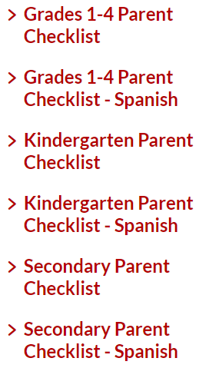
Online Parent Checklist Submission
KatyISD Website

Slide 6
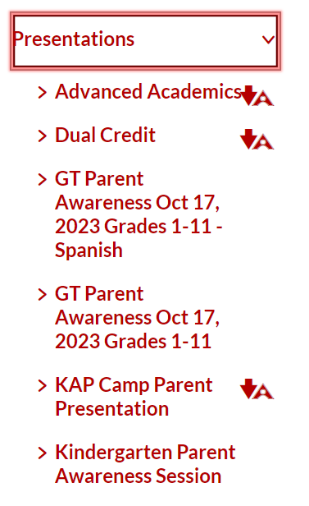
Parent Information Sessions
On the GT/AAS district website
Recordings are posted after any trainings
.

Slide 7
Overview of GT Screening
Parent Checklist
Qualitative
Classroom Observation
Qualitative
Phase 1
Quantitative
Ability Measure
Phase 2
Quantitative
Achievement Measure
Phase 3
Quantitative
Aptitude Measure

Slide 8
Elementary Challenge
2
Pull-out Program
GT students attend the Challenge classroom one day per week with other GT students - designated by grade level.
Project/Problem Based
Students work on projects and problems to explore their learning in more complex and hands-on methods
Challenge Cycle
The curriculum is focused on one theme each year with three connected units of study.

Slide 9
YEAR FIVE - Systems
Ecosystems, Economics, Energy
YEAR ONE - Change
Meteorology, Fine Arts, Chemistry
Katy ISD Elementary Challenge Curriculum Cycle
YEAR FOUR - Exploration
Astronomy, Archaeology, Architecture
YEAR TWO - Innovation
Technology, Medicine, Law
YEAR THREE - Patterns
Geological Forces, Cranial Connections, Oceanography

Slide 10
Secondary Advanced Academics
KAP/AP
GT KAP/AP
Dual Credit

Slide 11
Secondary GT Facilitators
3
Serve as a resource to GT parents
Screening & Identification
Work with Teachers and ICs to support instruction
Support the learning of GT student on campus
Conference with GT students
Develop and deliver PD
Collaborate with counseling team

Slide 12
AP/KAP
4

Slide 13
Purpose of Katy Advanced Program (KAP)
● Foster the development of academic skills necessary for Advanced Placement (AP) in high school
● Provide an opportunity to engage in challenging coursework in a low-risk environment (Junior High)
● Expose students to critical thinking and reasoning tasks intended to build academic stamina

Slide 14
Advanced Placement
College-level courses taken in high school
Designed and administered by the College Board
Students may receive college credit by taking an AP Exam. Katy ISD offers AP courses in Math, Science, Social Studies, English, World Languages, Fine Arts, and Computer Science
A 3 or better on an AP Exam generally translates to college credit.

Slide 15
Dual Credit
5

Slide 16
Advantages for Students
College-level courses taken in high school
Freshman-level courses
Industry certifications
Early completion of college credits
Reduced tuition/books costs to students and families

Slide 17
Dual Credit Courses*
English
Math
Industry Certification
History
Education
Spanish
Government
Economics
Science
*Not all courses are offered at every high school (depends on student selections).

Slide 18
Tuition Reimbursement Program for Dual Credit Teachers
Increase the
Number of
Embedded
Teachers
Master’s Degree
18 hours of graduate work in subject area
Tuition Reimbursement
1
2
3

Slide 19
In the last two years…
16 teachers identified as eligible to teach DC through advertising
13 in progress
11 completed
9 high school campuses participating
252 course hours completed by participants

Slide 20
Highlights of our work
Focus: Giving students problems to solve.
Expanded screening opportunities
Nearly doubled the number of students screened since 2020-21
Implemented a kindergarten universal screener
Services
All secondary campuses offer advanced coursework for all students
All elementary campuses serve GT students in the pull-out program
Dual Credit
Increased course offerings for 2024-25 school year
Helping teachers get Dual Credit teaching credentials

Slide 21
Thank You!

